Slide 1
Dictionary Learning
CSCI 4360/6360 Data Science II

Slide 2
Embeddings
Linear
Principal Components Analysis (PCA)
Sparse & Kernel PCA (last Thursday!)
Independent Components Analysis (ICA)
Non-negative Matrix Factorization (NMF)
Locally-linear Embeddings (LLE)
Dictionary Learning (today!)
Sparse & Nonlinear
Non-Gaussian
Non-negative
Nonlinear
Sparse & Nonlinear

Slide 3
Dictionary Learning
“Given a set of signals belonging to a certain class, one wishes to extract the relevant information by identifying the generating causes; that is, recovering the elementary signals (atoms) that efficiently represent the data.”
Regularization, Optimization, Kernels, and Support Vector Machines, Ch. 2
Every embedding strategy ever?

Slide 4
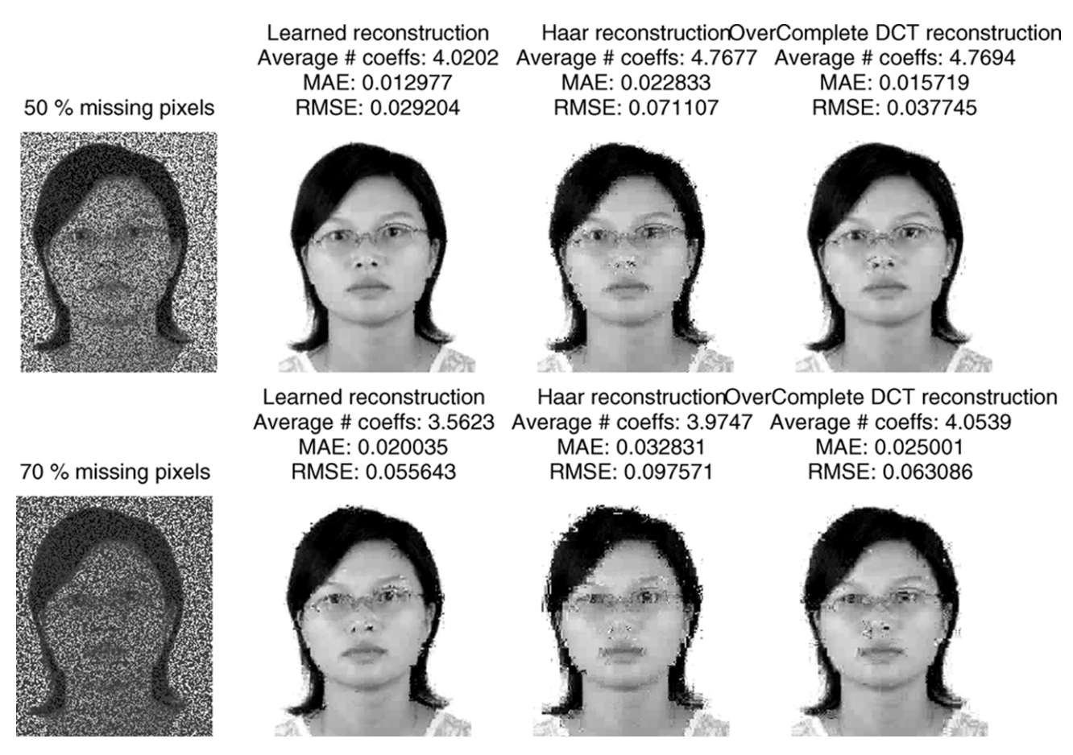
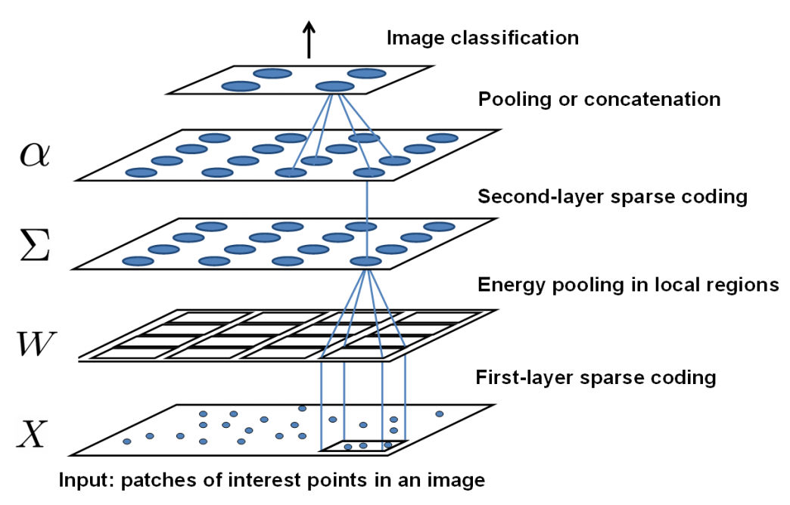
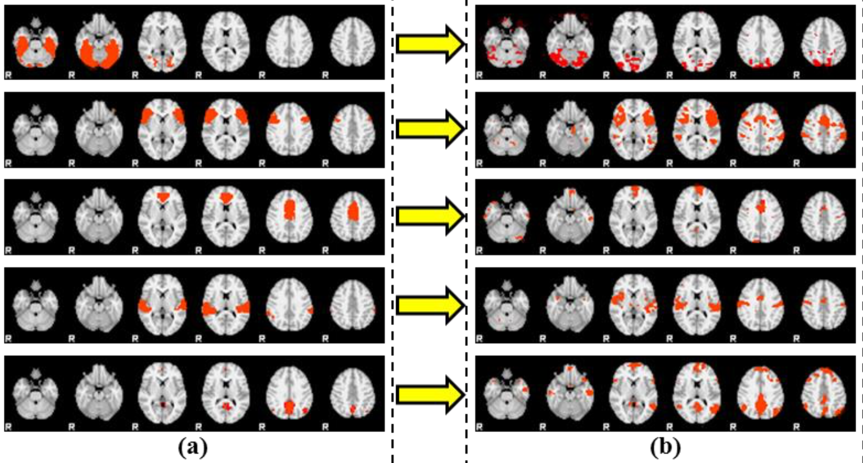
Dictionary Learning
Sparse coding
l^{p} sparsity
Hierarchical sparse coding
K-SVD
Elastic net

Slide 5
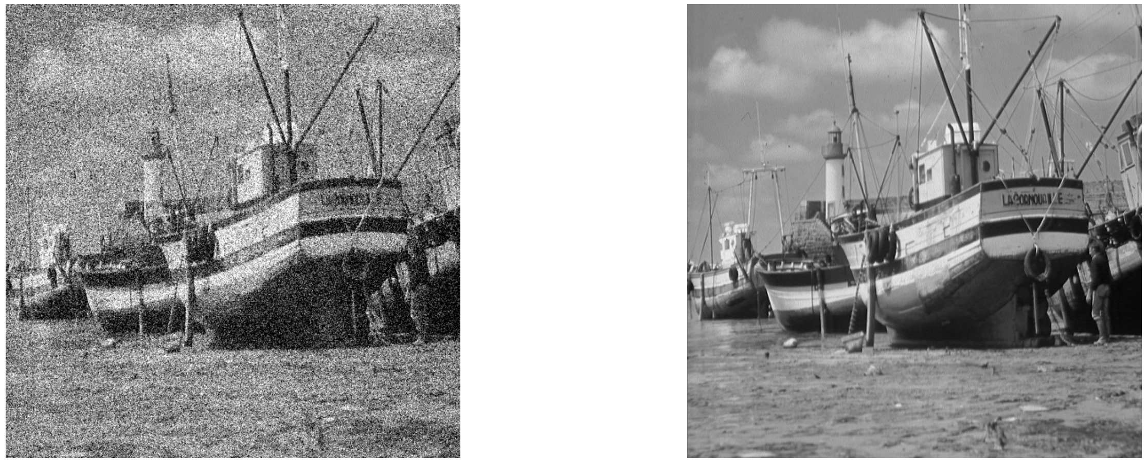

Motivations
Dictionary learning is ideally formulated for image denoising (and is indeed a major application of dictionary learning)
Measurements (image)
Noise
Original image

Slide 6





Motivations
Easily converted to an energy minimization problem
Some classical priors
Smoothness
Total variation
Wavelet sparsity
Lasso
…
Energy minimization becomes a MAP estimation!

Slide 7

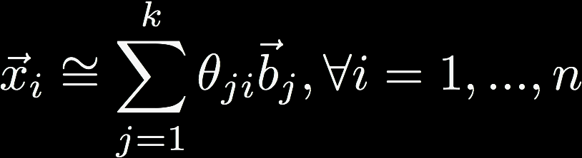
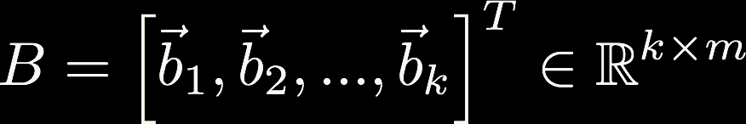
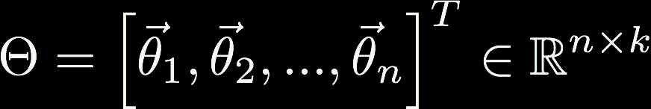
Dictionary Learning
We have our data X
and wish to represent it using some small number k atoms (k <<< n)
When combined with coefficients, the linear combinations with the atoms should yield a nearly complete representation of X
Notes:
B is the dictionary
Theta are the coefficients, or codes (want these to be sparse)

Slide 8
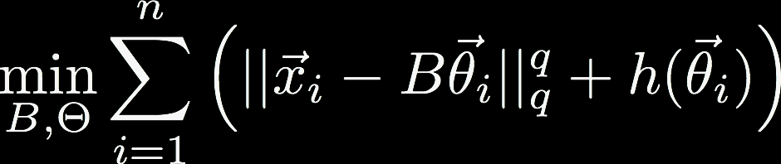

Dictionary Learning
This gives the minimization where h promotes sparsity in the coefficients, and B is chosen from a constraint set
The general dictionary learning problem then follows where specific choices of h and g are what differentiate the different kinds of dictionary learning (e.g. hierarchical, K-SVD, etc)

Slide 9
Dictionary Learning vs PCA
Remember the operational definition of PCA?
Orthogonal projection of data
Lower-dimensional linear space known as the principal subspace
Variance of the projected data is maximized
Dictionary Learning (sparse coding)
Minimize reconstruction error
Linear combination of atoms
Sparse, overcomplete basis
Objectives are reconstruction, sparsity, and redundancy
Two definitions of PCA
Maximizing Variance
Minimizing Reconstruction Error

Slide 10
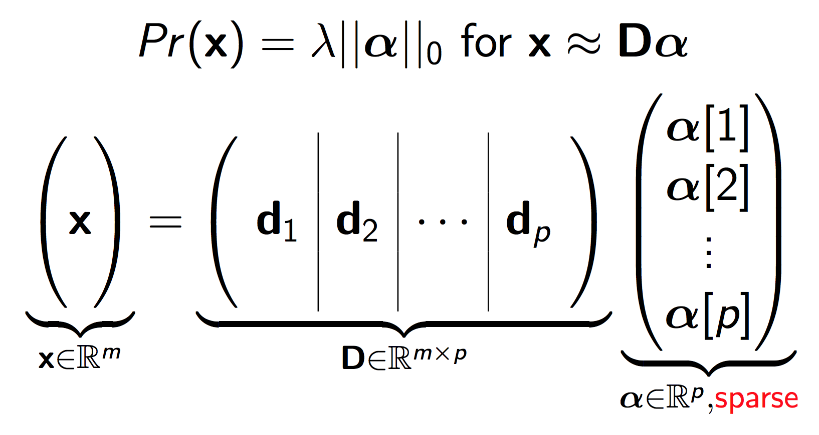
Dictionary Learning

Slide 11
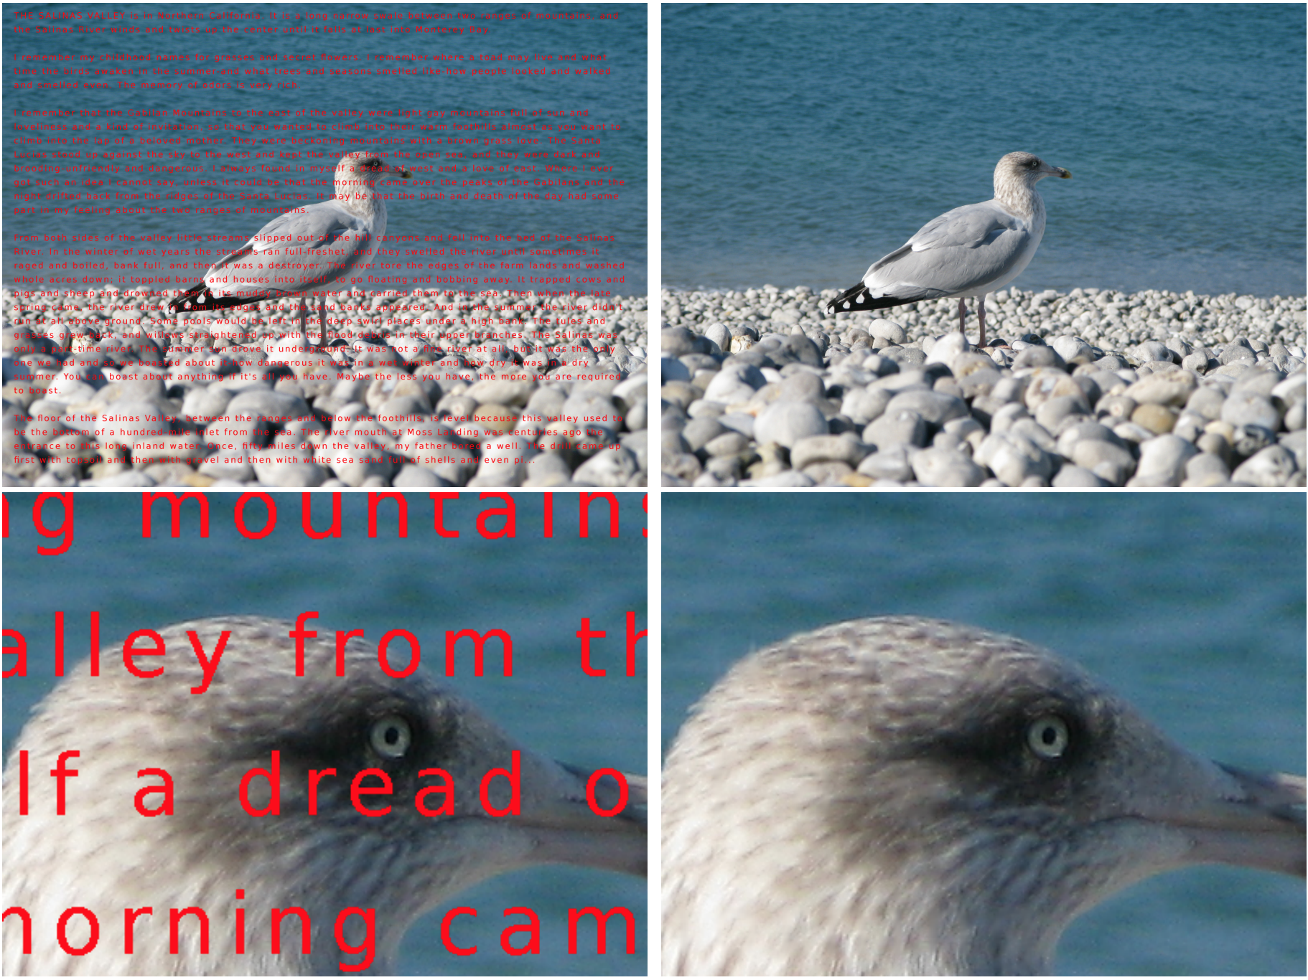
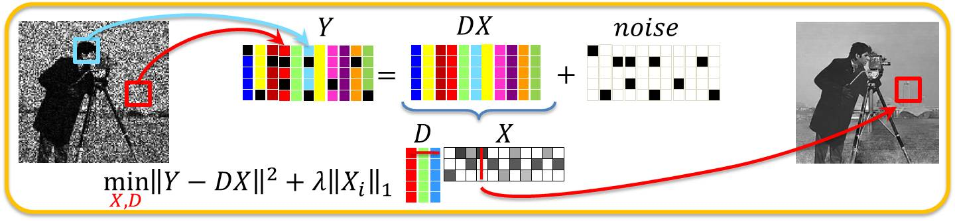
Applications
Image denoising
Sparse basis forces out noise
Identification of functional networks of neurons
Image, video, audio processing
Clustering
Bag-of-words modeling for object categorization
Image restoration & inpainting

Slide 12

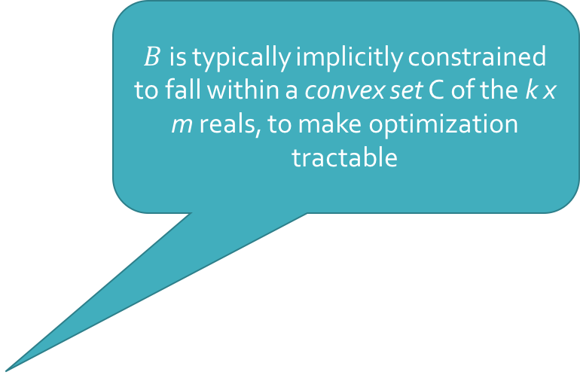
Dictionary Learning
$B$ is typically implicitly constrained to fall within a convex set C of the k x m reals, to make optimization tractable
General formulation
More common: set g to identity*, and h to L₁ norm
Notes:
The convex set is implicit, but necessary, to ensure that the coefficients do not vanish & thereby make the regularization effect disappear

Slide 13
Optimization
Problems with the objective function?
Squared loss is convex
Regularization is convex
Squared loss + regularization is not convex
Even worse, often non-smooth

Slide 14


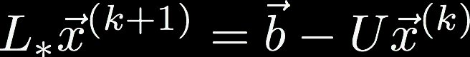
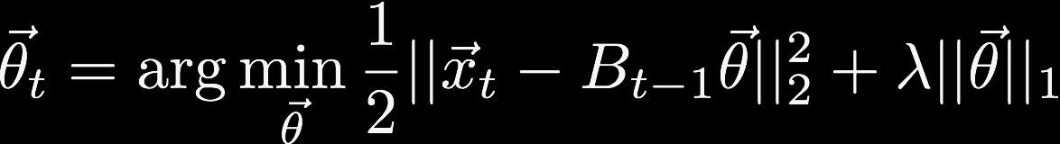
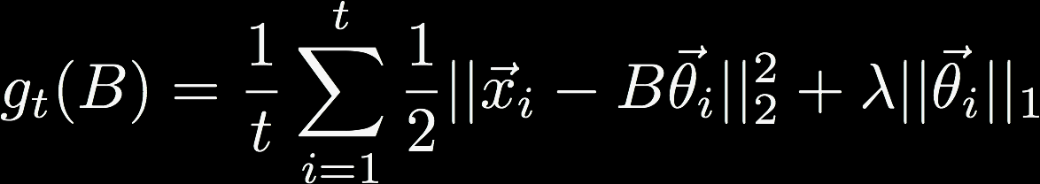
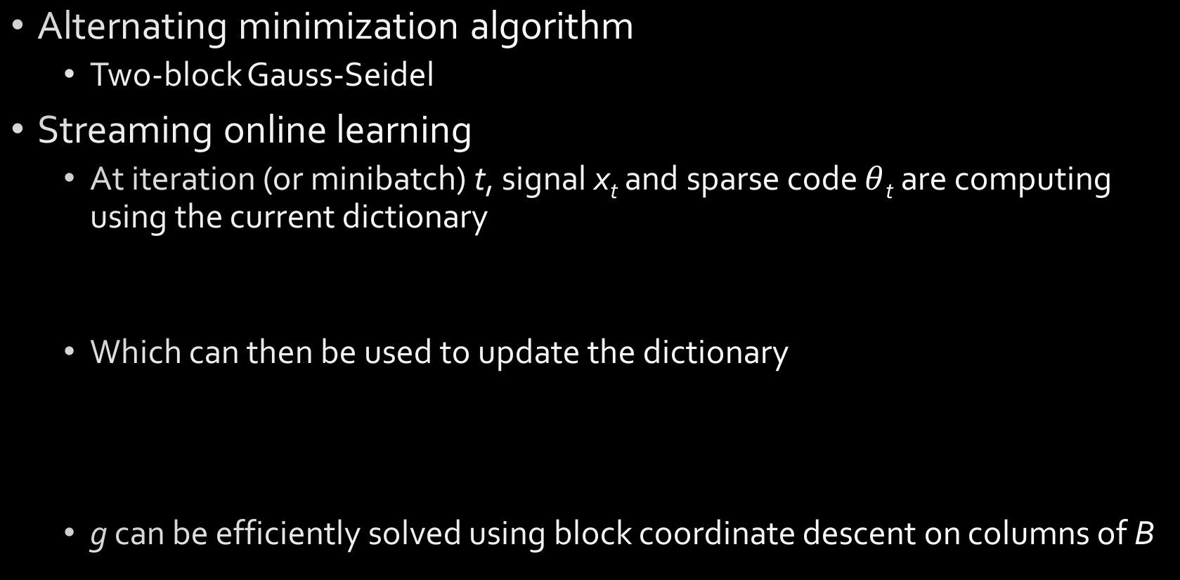
Optimization
Alternating minimization algorithm
Two-block Gauss-Seidel
Streaming online learning
At iteration (or minibatch) t, signal x_{t} and sparse code $θ$_{t} are computing using the current dictionary
Which can then be used to update the dictionary
g can be efficiently solved using block coordinate descent on columns of B

Slide 15
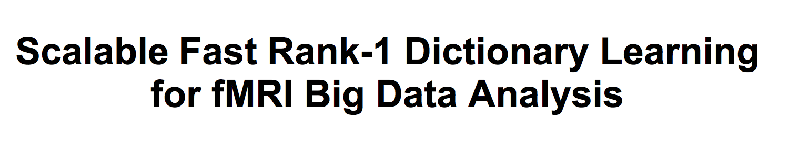
Rank-1 Dictionary Learning (R1DL)
KDD 2016
“Scalable fast”

Slide 16
R1DL
Reformulates dictionary learning as an alternating least-squares problem
(embraces the optimization procedure)
Uses 0-”norm” instead of L₁
Given rank-1 formulation, this is an inexpensive way of guaranteeing sparsity
Iteratively learns rank-1 dictionary atoms until k have been found
”Deflates” data matrix on each iteration

Slide 17

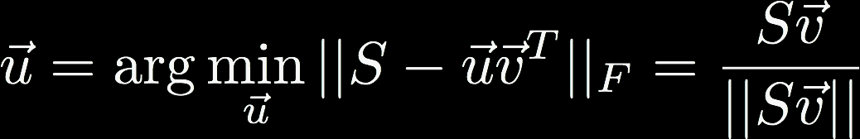



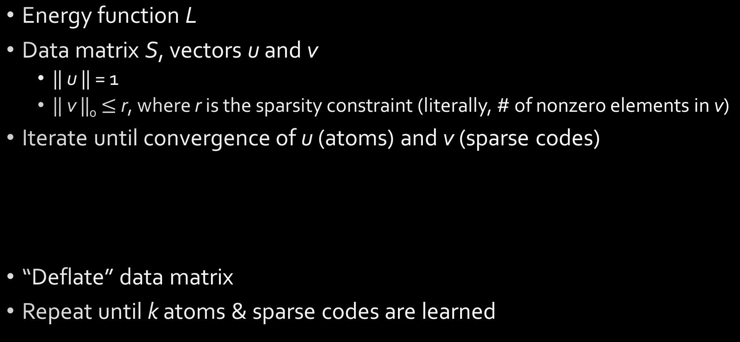
R1DL
Energy function L
Data matrix S, vectors u and v
|| u || = 1
|| v ||₀ $≤$ r, where r is the sparsity constraint (literally, # of nonzero elements in v)
Iterate until convergence of u (atoms) and v (sparse codes)
“Deflate” data matrix
Repeat until k atoms & sparse codes are learned

Slide 18
Summary
Dictionary learning is focused on developing a basis of atoms and coefficients
Coefficients are sparse
Atoms form an overcomplete representation of the data
Chosen to minimize reconstruction error
Explicitly factorizes out noise
Can be customized in the form of a prior
Optimization is often non-convex and non-smooth, requiring alternating minimization strategies or online learning
R1DL focuses on leveraging optimization strategies to iteratively learn the basis, one atom at a time
Other variants include K-SVD, Hierarchical DL, and Elastic Net

Slide 19
Questions?

Slide 20
Course Details
Assignment 5 is out!
The final assignment!
Due Tuesday, November 5
Students in the other class have entered Slack!
Start chatting with them ☺
…technically required for Assignment 5
Next week:
Conclude dimensionality reduction on Tuesday
Begin neural networks on Thursday
November is all NNs, all the time

Slide 21
References
“Sparse coding with an overcomplete basis set: A strategy employed by V1?”, http://www.sciencedirect.com/science/article/pii/S0042698997001697
“Learning image representations from the pixel level via hierarchical sparse coding”, https://pdfs.semanticscholar.org/96be/a45d9b962c8159883a0d07493a2ea42784e4.pdf
“K-SVD: An Algorithm for Designing Overcomplete Dictionaries for Sparse Representation”, http://www.cs.technion.ac.il/~freddy/papers/120.pdf
“Scalable Fast Rank-1 Dictionary Learning for fMRI Big Data Analysis”, http://www.kdd.org/kdd2016/papers/files/adp0864-li.pdf
“Dictionary learning for sparse coding: Algorithms and convergence analysis”, https://pdfs.semanticscholar.org/284d/9c3702b8820e2bd89b1c96532f12b3afb336.pdf
“Sparse Coding and Dictionary Learning for Image Analysis”, https://lear.inrialpes.fr/people/mairal/tutorial_iccv09/tuto_part2.pdf

